Slide 1
The lazy and easily distracted report writer
Mike K Smith (Pfizer R&D UK Ltd.)
@MikeKSmith
RStudio::conf(2019)
Notes:
Thanks to the conference organisers for inviting me to present today.
My name is Mike K Smith and I work for Pfizer R&D UK Ltd in Sandwich, UK
I’m going to talk to you today about being lazy and easily distracted, and how parameterised markdown reports can make life easier if you are similarly afflicted.

Slide 2
TL;DR & Disclaimer
I used parameterised rmarkdown notebooks to write up an exploratory analysis which I shared with a drug development team consisting of quantitative and non-quantitative colleagues:
Statistician
Clinical Pharmacologists (including my manager)
Clinician
The analysis presented here is NOT that analysis (for confidentiality) but it has similar attributes.
Notes:
As a summary of this presentation and partly as a disclaimer
I used rmarkdown notebooks to write up an exploratory data analysis which was shared to a drug development team consisting of both quantitative viewers – the statistician, the clinical pharmacologists (which included my manager) and also non-quantitative or potentially non-quantitative folks such as the clinician on the team.
The analysis I’m presenting today is NOT that analysis, because of confidentiality of data, but what I WILL show has very similar attributes.

Slide 3
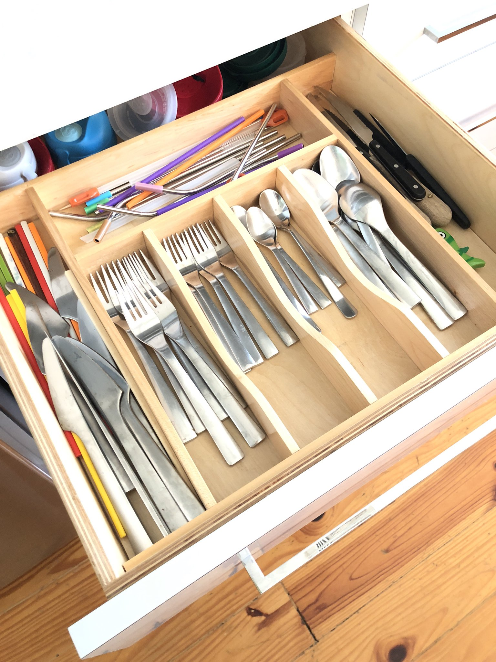
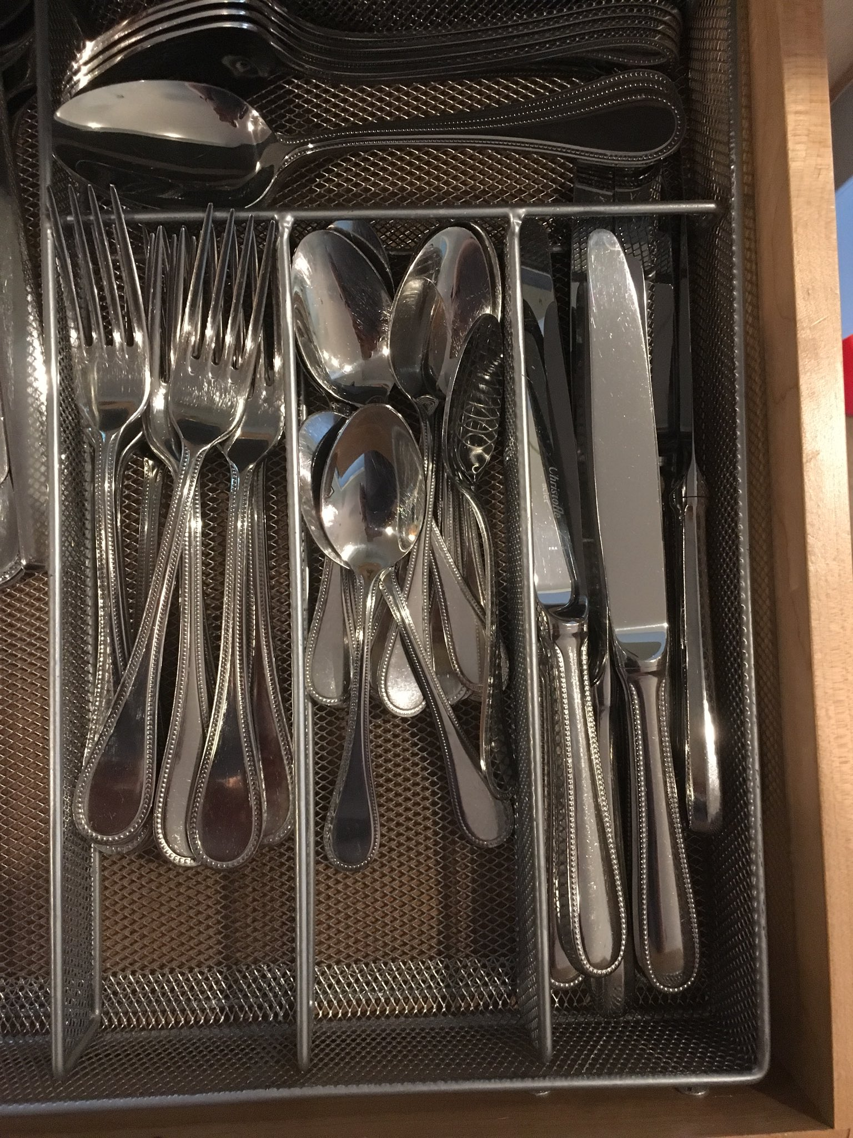
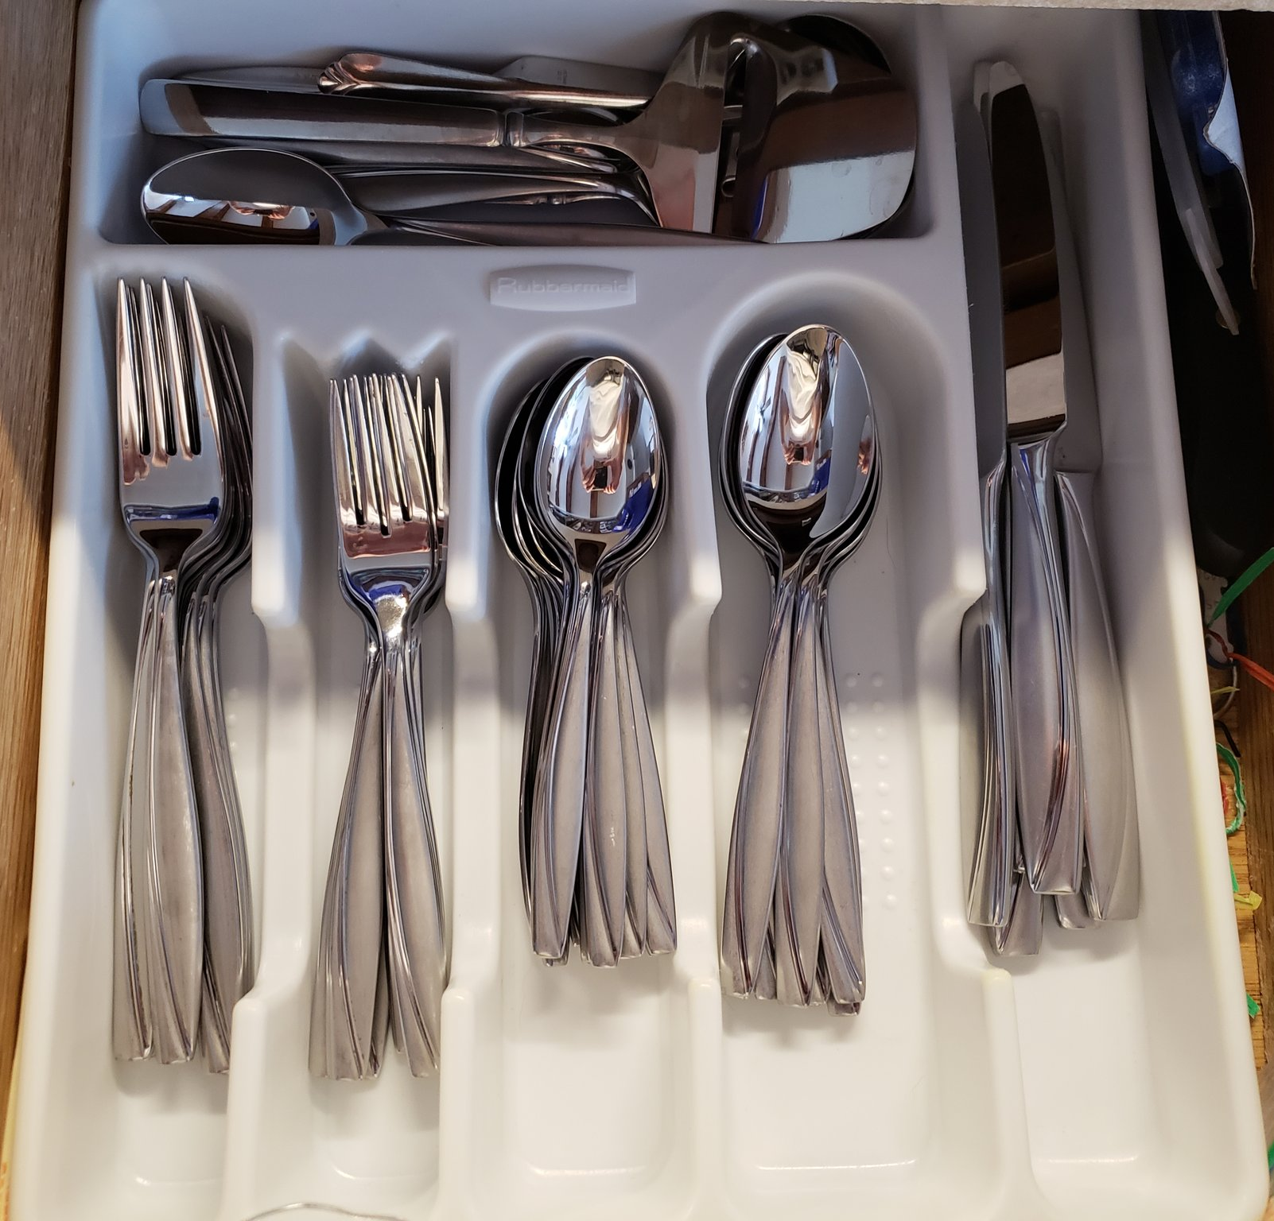
Cutlery drawers &
what they say about YOU
HT: @HadleyWickham, @jimhester_, @dataandme
Notes:
But what I REALLY want to talk to you about today is cutlery drawers.These are cutlery drawers of some folks that you might encounter at this conference and they were shared on Twitter and they sparked a debate about cutlery drawer organisation…Do knives go on the left, or right, do you parse out large and small forks and spoons, do you organise by "most used"...

Slide 4
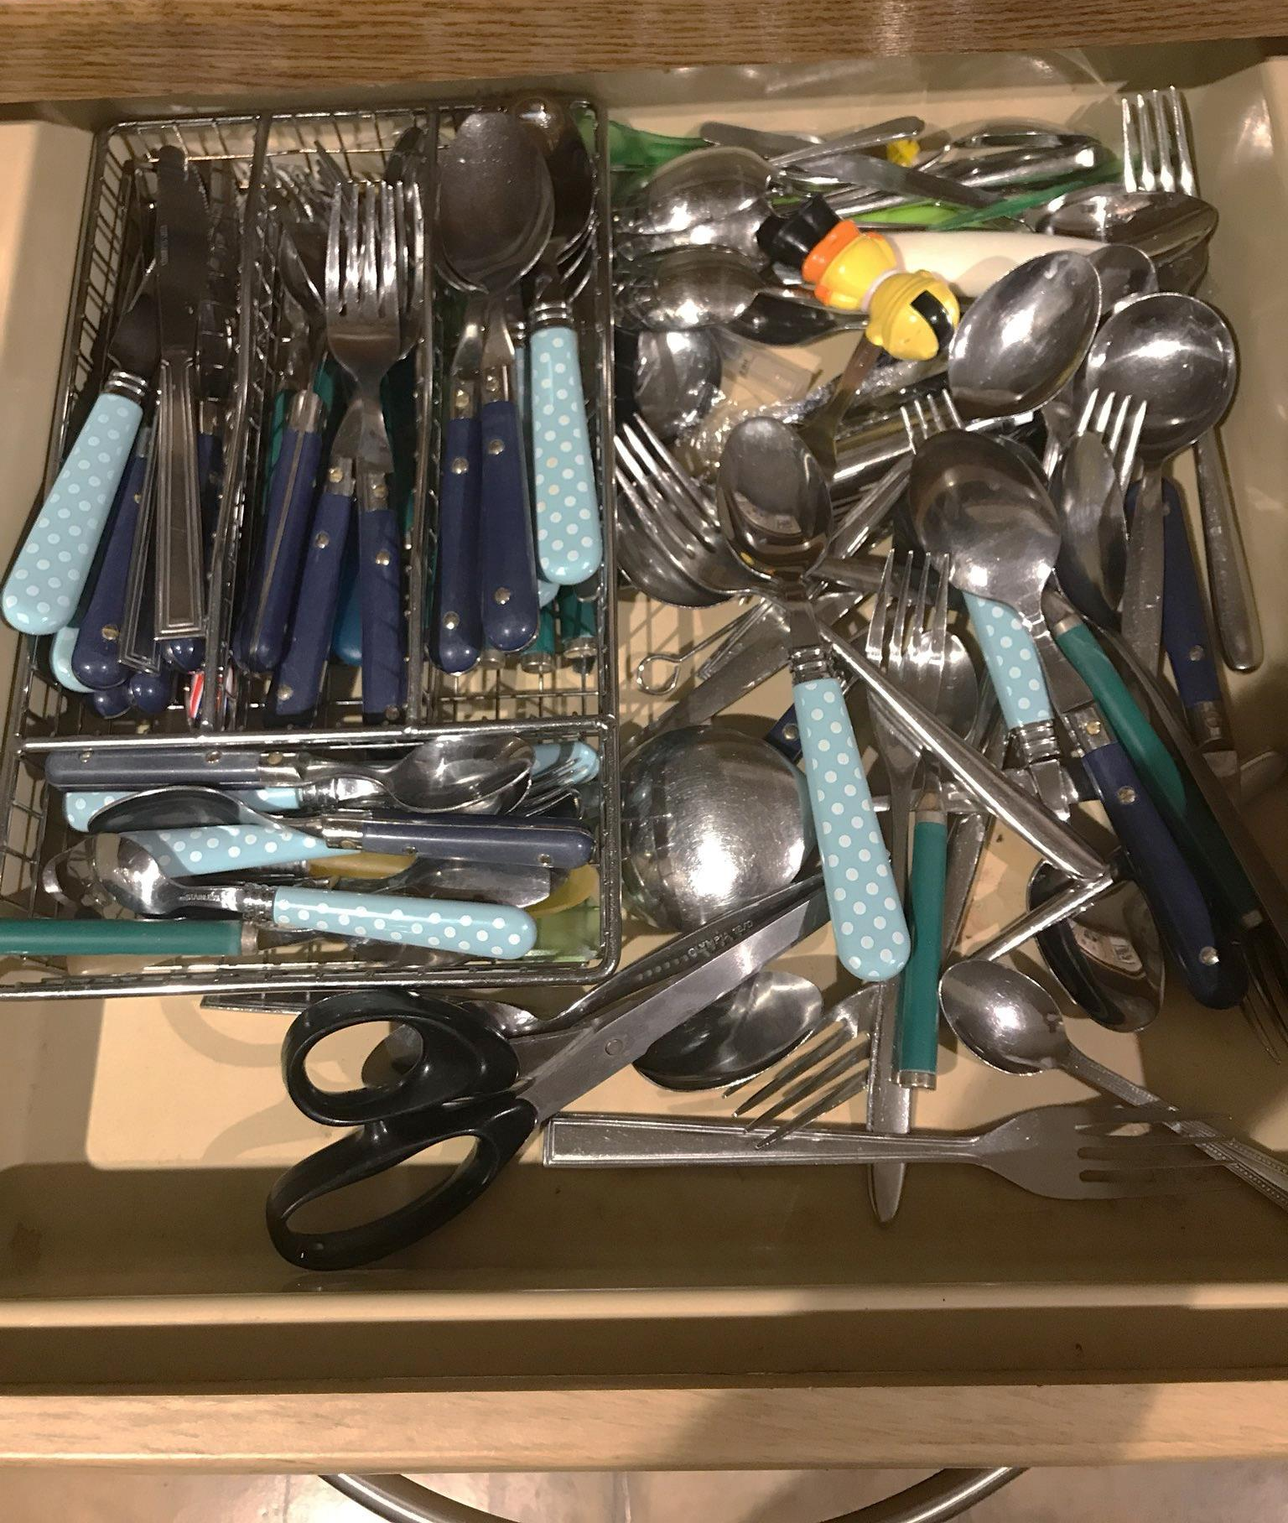
Mine… (sorry / not sorry)
CutleryDrawer %>%
group_by(Type) %>%
gather( ) %>%
arrange( )
#untidyverse
Notes:
Here’s mine.If you visit my home, this is what you'll see. My wife will also be quite surprised that you’re visiting and she'll be even more surprised that you only want to see the cutlery drawer.
Yes, it could probably do with a decent amount of application of the “group_by”, “gather” and “arrange” functions.

Slide 5
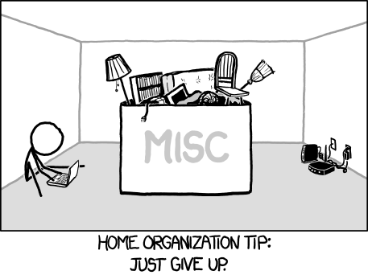
https://xkcd.com/1077/
Notes:
Fortunately I found that XKCD has similar thoughts about home organisation…
If you’ve got wifi and a laptop then basically everything else can get chucked into a big bucket labelled “Miscellaneous”.

Slide 6
Your (my) brain is lazy, shallow, and easily distracted.
https://www.slideshare.net/CJAtherton/chris-atherton-at-presentation-camp-london
Notes:
My brain is shallow, lazy and easily distracted. I hesitate to say that YOUR brain is also lazy, shallow and easily distracted but Joe Cheng stood up on the platform yesterday and said that our intuition sucked, so I'm going to go out on a limb and suggest that there MAY be others in the audience for whom this is true.

Slide 7
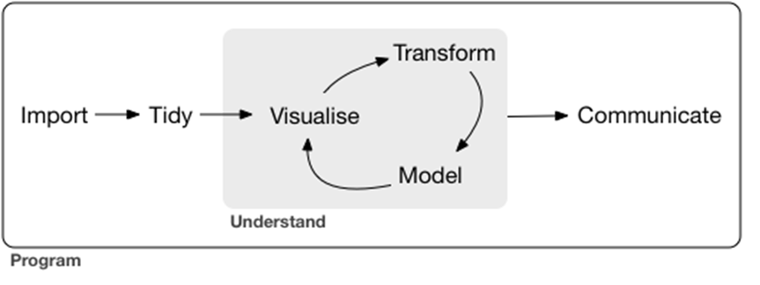
Data analysis - THEORY
https://r4ds.had.co.nz/
Notes:
I’m assuming that if you’re at this conference then you’re likely to have seen this diagram.There has been some recent discussion on the Not So Standard Deviations podcast about this diagram, which I think concluded with the agreement that this was a mental model and just a “Theoretical” framework. I don’t have a problem with that definition.

Slide 8
Data Analysis – In practice….
(DISCLAIMER: I’m sure the experiences
recounted here are unique to me alone.)
Notes:
What I’d like to discuss now is a little bit around my own, personal experience of how a typical data analysis might go.
Disclaimer here that these experiences are unique to me alone. I submit the cutlery drawer pictures as Exhibit A.

Slide 9
Go to email with link to data source…
read and respond to 3 other emails…
Download and read data into R…
stop and answer colleague’s question(s)
about the tidyverse…
Wrangle data and plot it…
Notes:
So typically I get a notification via email that the data is available on some data source,
I download this and read it into R.
I wrangle the data, try to understand and plot it.

Slide 10
LUNCH
go to an (unrelated) meeting / teleconference call.
Notes:
Then there may be some time to think carefully and plan the next steps of my analysis

Slide 11
Make better plots.
follow an interesting link that
Mara Averick (@dataandme)
just posted on Twitter
Fit preliminary model to data.
Notes:
Which may include revisiting the graphs I made earlier
And perhaps fit a preliminary model to the data.

Slide 12
<Next day>
Team find problem with data,
share new version of data.
Change input data and redo analysis.
Check new version against
previous version.
Notes:
The following day I arrive at work to find an email saying that the team have found some issue with the data and have shared an updated version of the data.
Which is fine.
So I change the input dataset and redo the analysis.
Before I finish I check my results with the new dataset against those from yesterday’s data to see what the impact was on inference.

Slide 13
Discuss findings with my boss.
file expenses.
Circulate report.
DONE!!!
Notes:
I then have a discussion with my boss to brief him on what I’m seeing and if all is well then I circulate the report…
And we’re DONE.
Hang on.
Sorry.
Were you distracted by the text in light grey?
Yes?
Ah, so it’s NOT just me that gets distracted then...
And did anyone notice that the "Visualise" and "Transform" items in the R For Data Science diagram were back to front?
Score 1 to Cognitive Load Theory.

Slide 14
< 6 months pass >
Review comments come back…
Wait… Erm… WHAT was I thinking?
Notes:
No word of a lie, I got an email YESTERDAY from my boss about this analysis and asking me to get back in touch with the project team to discuss it with them. And if you've just written a script which is NOT reproducible then at this point you're going to be in a world of hurt... Because you'll pop open the script and wonder what the HECK you were thinking 6 months ago.

Slide 15


To the rescue…
rmarkdown & notebooks
Notes:
So, to the rescue comes rmarkdown and notebooks.
Thanks to Yihui and team at RStudio who are working on these things.

Slide 16
Who is your audience?
Present (distracted) me
Future (6 months later) me
Quantitative colleagues / reviewers
Decision makers (may not be quantitative)
Notes:
First rule of writing: who is your audience?
Well in this case it was for the distracted version of me in the present. Notebooks allowed me to capture my thought process, code, outputs, assumptions, conclusions, To Do tasks, everything.
And if I do a good job for me in the present, you just KNOW they’re going to be equally useful in 6 months time when I have to revisit this analysis and try to fathom just what it was that I was thinking back then.
And there are some really nice features of markdown and knitr that allow me to tailor the report.
Quantitative folks might want to see the code – to review that what I’ve done and how – and they might also want to see more discussion around data transformations that I’ve done.
But there may be non-quantitative folks who really don’t need to see detail, but just want to know the results to decide what to do next.

Slide 17
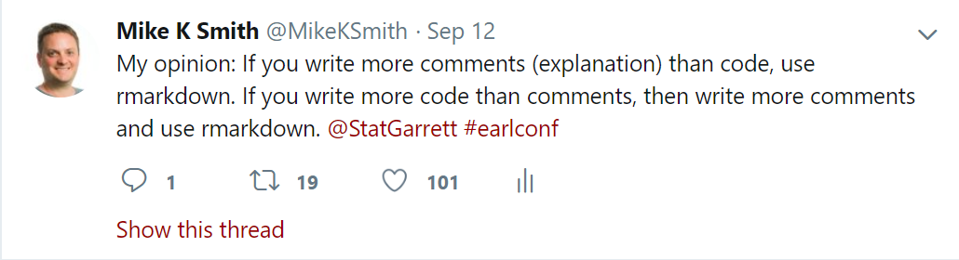
Notebooks / markdown vs scripts (for analysis)
BUT, see also: https://yihui.name/en/2018/09/notebook-war/
Notes:
Now, a little word about the notebook wars…
Due to my inherent laziness, I’m shockingly bad at annotating my code in scripts, and notebooks keep me honest.
Just to be clear, the advice here is just for using notebooks and rmarkdown for capturing ANALYSIS not for functions or scripts in other circumstances. For more details see Yihui’s blog post here.
If you’re writing more comments than code, then use rmarkdown and notebooks.
If you’re writing more code than comments, then write more comments and use rmarkdown and notebooks.
But if you're NOT writing for analysis then I encourage you to read the blog post from Yihui in the link.

Slide 18
Also…
I knew my manager / other reviewers would ask for reports on the THREE different endpoints.
Notes:
I should also say at this point that while I was busy working on my exploratory analysis for ONE endpoint, I just KNEW that I’d be asked to do the same for the other two endpoints.

Slide 19
Rule of three
Copy & paste code ≥3 times?
Write and use a function
Perform analysis across ≥ 3 endpoints?
Multiple markdown reports?
NOPE. Parameterised reports.
Notes:
Which brings us to the “Rule of three”.
Now, pop quiz: What do you do if you find yourself copying and pasting code more than 3 times?
Yep. Write and use a function.
But what do you do if you have to perform an analysis across more than 3 endpoints?
Yes, that’s right. Use parameterised reports.

Slide 20
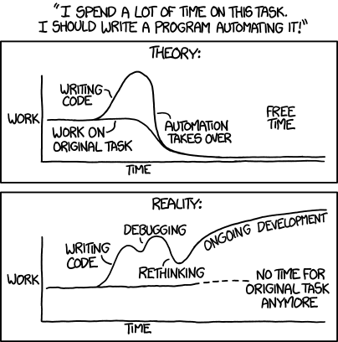
https://xkcd.com/1319/
Notes:
Before we go further, let’s turn back to XKCD to get Randall Munroe’s advice about automation.
In THEORY it ought to save us time in the long run if we spend some time automating the task.
But the reality might be slightly different…

Slide 21
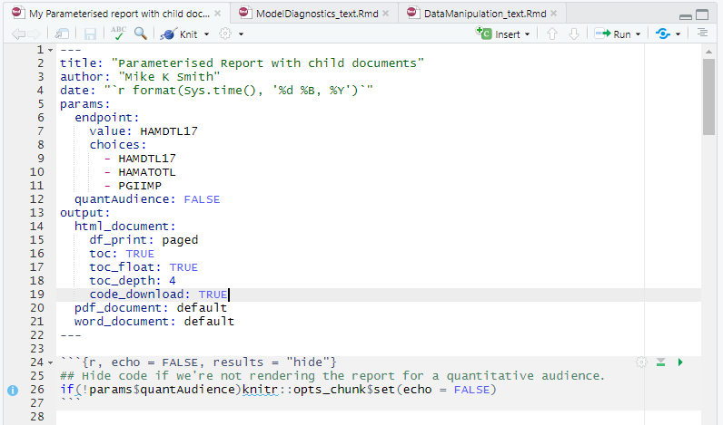
YAML header parameters
Parameters that can be used
in the code / knitr options.
Note that endpoint has only three choices,
and a default value (HAMDTL17)
NB. A bit like Shiny inputs
Notes:
What makes parameterised reports work is the specification of the parameters in the YAML header.
We need to define the parameters, what they are called and if they have any default values.
So in this report I have a parameter called endpoint which will take the name of each possible endpoint for analysis.
You can see another option here which is to specify the unique choices for the endpoint.
And I’ve also specified a boolean that allows me to control whether the report is for a quantitative audience or not.

Slide 22
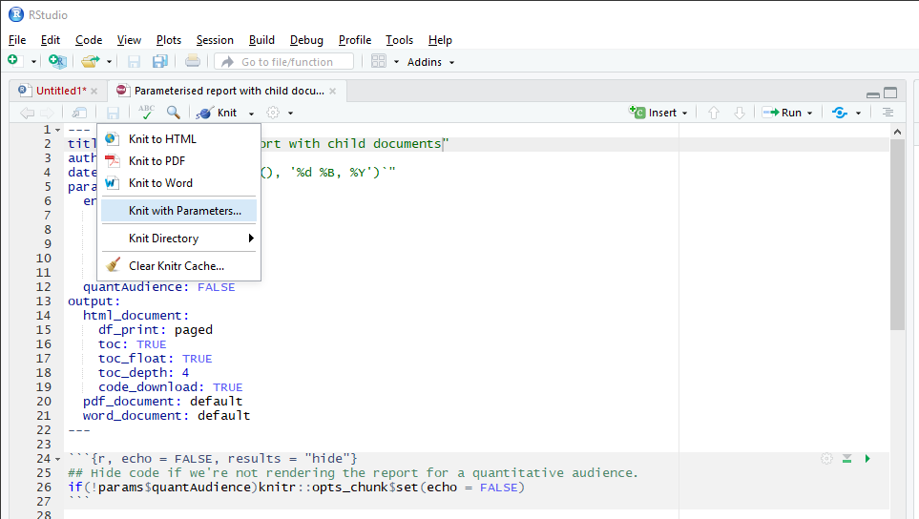
Render with parameters
Notes:
Then, when I knit and render this report I can choose to knit with parameters

Slide 23
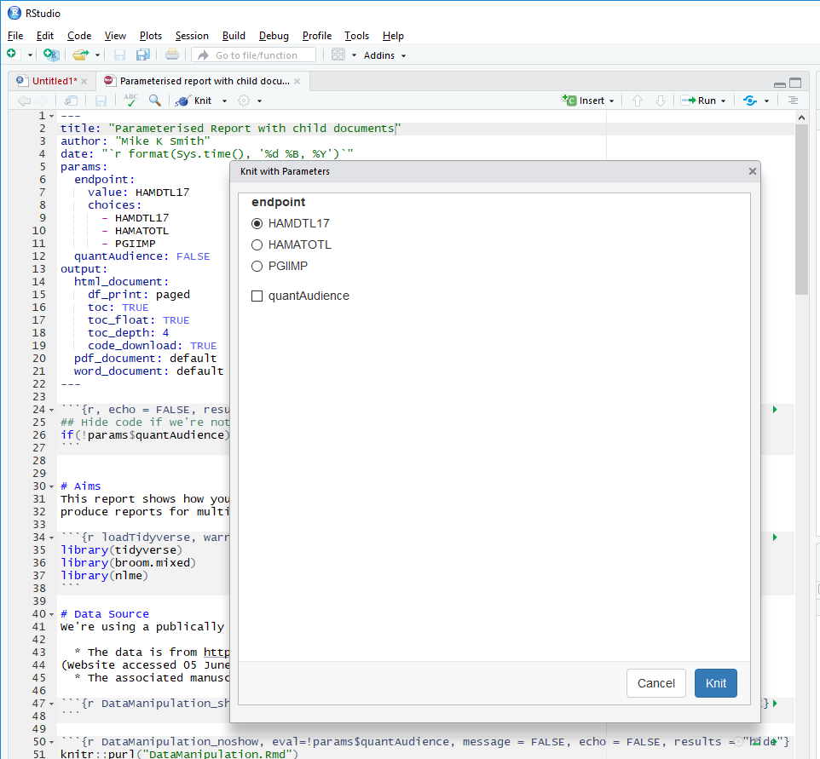
Render with parameters
Notes:
Which pops up a window allowing me to select the parameters to be used in that render.
I can also do this at the command line by passing in a list of parameter values as arguments to the render function.

Slide 24
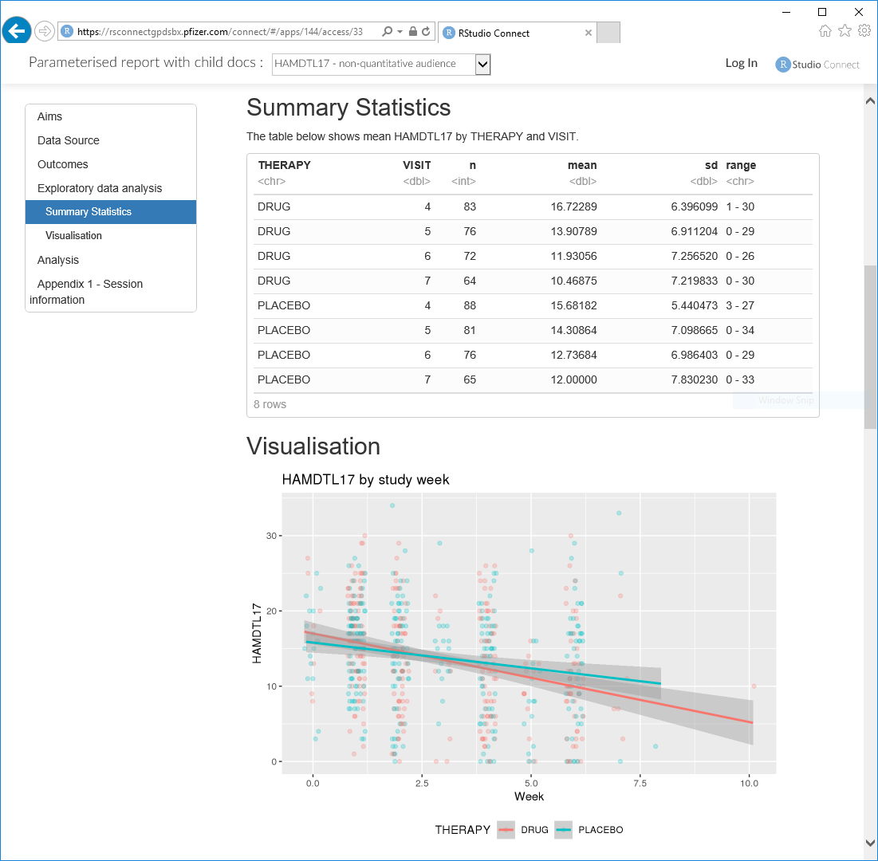
params:
endpoint: HAMDTL17
quantAudience: FALSE
Using params$endpoint
in markdown text, plot code
Notes:
Now the good thing is that we can use the parameter throughout the markdown
Like here where I’ve used it in the markdown text, in the title for my plot, and as an axis label.

Slide 25
Knitr options:
Show code in output ONLY IF quantitative audience,
Notes:
I can also use the parameters in chunk settings so control what does and doesn’t happen in the rendering of my report.
So here, if the audience is NOT quantitative then I’m going to hide all my code in the report.

Slide 26
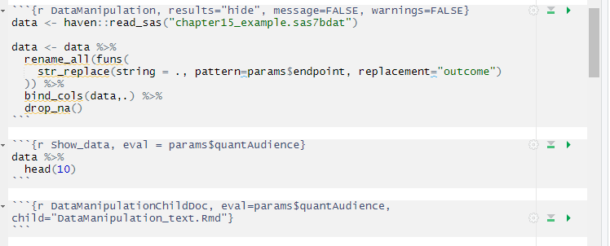
Rename endpoint variable(s) to “outcome” (simplifies later code)
Run this code ONLY IF params$quantAudience = TRUE
Run ONLY IF params$quantAudience = TRUE, to pull in text from child document
Notes:
I can also rename columns in my data from the endpoint name to something generic that I can use in subsequent analysis steps for summarising and fitting models.
I can control which chunks are run
And also pull in text from child documents to tailor the report for a given audience.

Slide 27
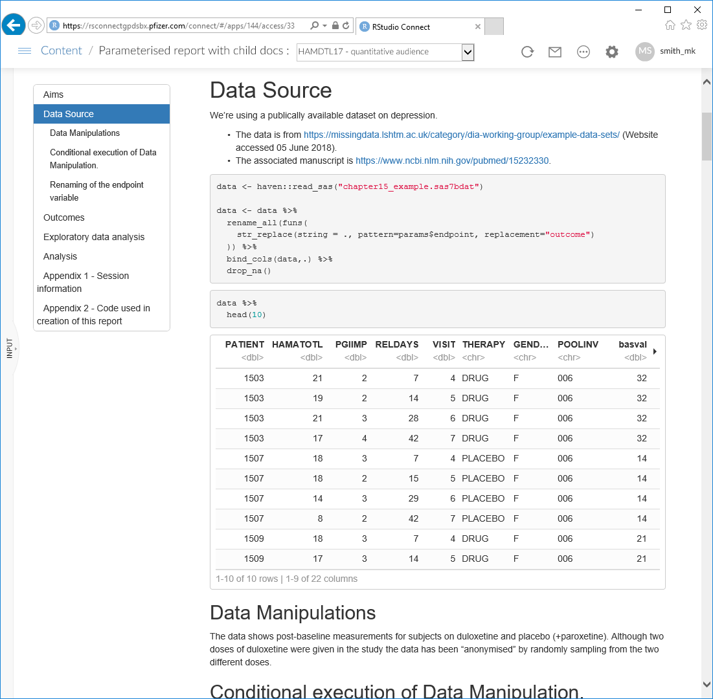
params:
endpoint: HAMDTL17
quantAudience: TRUE
Code shown
Chunk run
Data shown
Child doc text
Notes:
So here’s what it might look like for a quantitative audience.
I’m now showing code
I’m running a chunk to show the data
And I’m including a block of text from the child document to explain my data manipulations.

Slide 28
params:
endpoint: HAMDTL17
quantAudience: TRUE
RStudio Connect allows
you (or visitor to your
page) to specify parameters and render a parameterised report and then to save that report as a named item.
You can then have
pre-rendered reports for
various audiences ready
to go…
Notes:
Now if I push this report to Rstudio Connect, then I can compile the report ON THE SERVER using different parameter sets
And then have “pre-rendered” reports for the different endpoints and for difference audiences.

Slide 29
More parameterisation
Question: Can I pass in parameters from the render command?
You betcha! render(… , params=list( … ) )
Question: how to show correct analysis for non-continuous endpoint?
Change analysis type in code depending on params$endpoint.
Question: what to do if something goes wrong in the analysis?
Check for errors and handle appropriately using tryCatch(…)
Insert child document text: “EMERGENCY! Something has gone wrong… Contact your data scientist!”
Notes:
While I've shown you how to render with parameters via the GUI and in RStudio Connect, you CAN also pass parameters as a list in the rmarkdown::render function.
Of course, as XKCD points out, if you automate to this level you have to be a bit careful.
So if, in some other case, you had to tailor your analysis to allow for non-continuous outcomes, then you might have to condition chunks depending on the value of the endpoint parameter.
And also, if it’s an automated report then you may have to include some defensive programming to catch cases where the analysis doesn’t go as planned and provide sensible reporting.

Slide 30
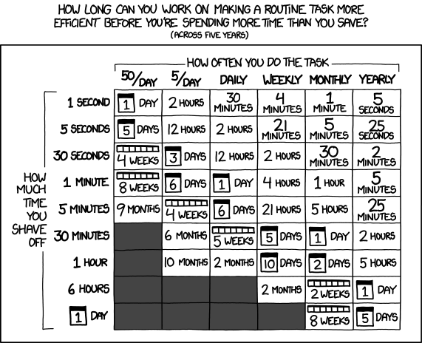
https://xkcd.com/1205/
Notes:
I know that JD Long is also talking about this graphic, and I encourage you to seek out that presentation afterwards to hear what he has to say on the matter...
But you should also bear in mind that the amount of time you take to implement all of this may not provide a good return on investment.
Even over five years.
But you might get a half-decent conference talk out of it.

Slide 31


Feel free to ask me questions, but remember…. #untidyverse
@MikeKSmith
https://github.com/MikeKSmith/RStudioConf2019
Notes:
So thanks for your attention

